Slide 1
Patient Controlled Epidural Analgesia
Joshua, Jian Rong, Louis

Slide 2
Scope
Qt GUI
SQLite Database
PCEA Infusion Algorithm

Slide 3
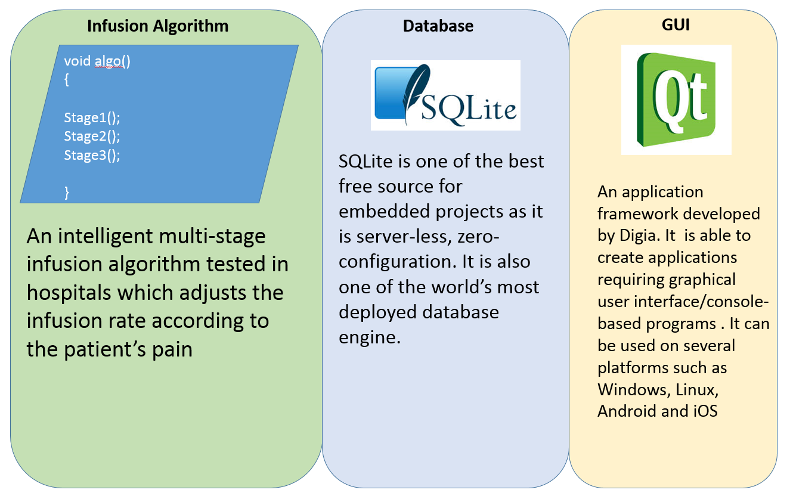

Slide 4
SQLite description
Self-contained
Server less and portable
Zero-configuration
Physical database stored in flash memory on the board
Small code foot print

Slide 5



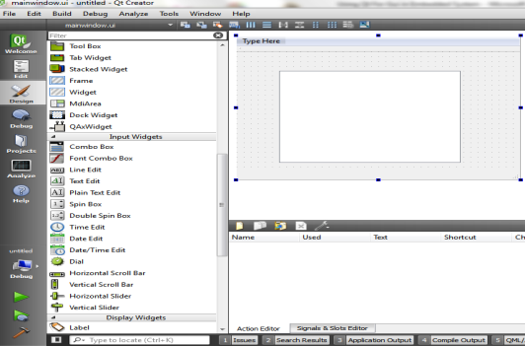


What is Qt?
An application framework developed by Digia
Create applications requiring GUI/console-based programs
Uses standard C++
Can be used on several platforms such as Windows, Linux, Android and iOS
Has own set of classes
Qt Creator

Slide 6
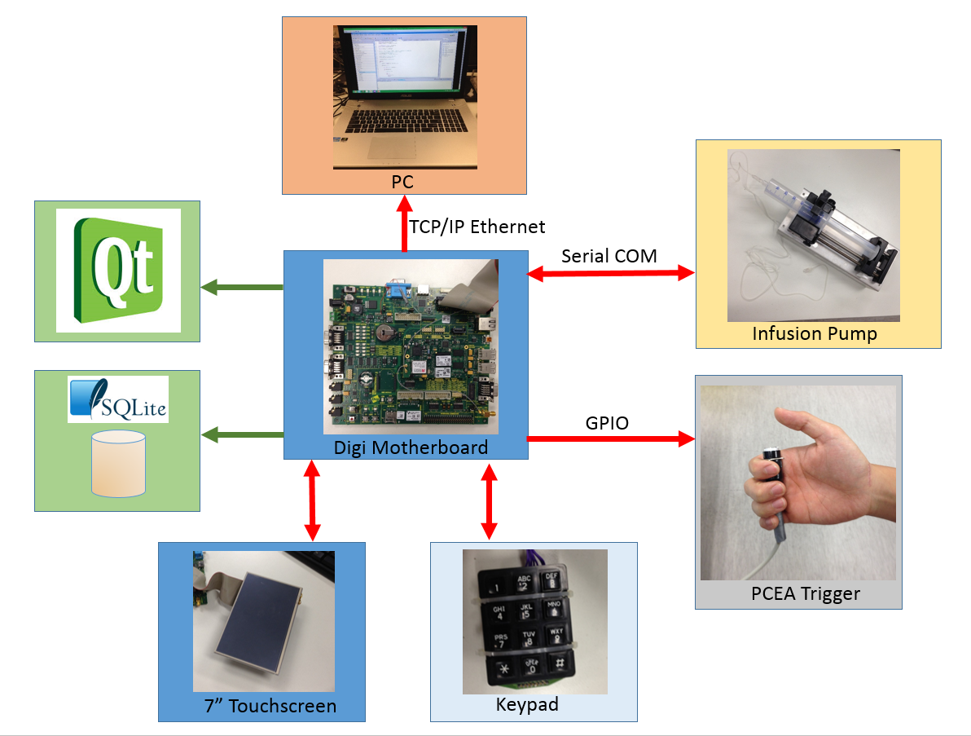

Slide 7
PCEA Infusion Algorithm
Based on a clinically tested algorithm invented by Prof. A.T. Sia
Multi Stage Design base on patient’s pain
Automated + Patient boluses

Slide 8
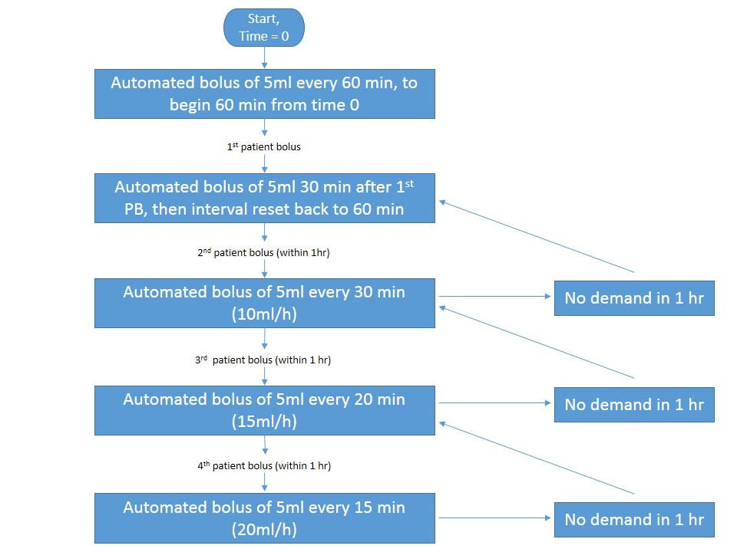
Algorithm Flowchart

Slide 9
Algorithm Prototype Program
Designed for easier development of the algorithm
Prints out current status of infusion in the GUI
Displays whether the infusion was successful or unsuccessful
Code in Visual Studio C#

Slide 10
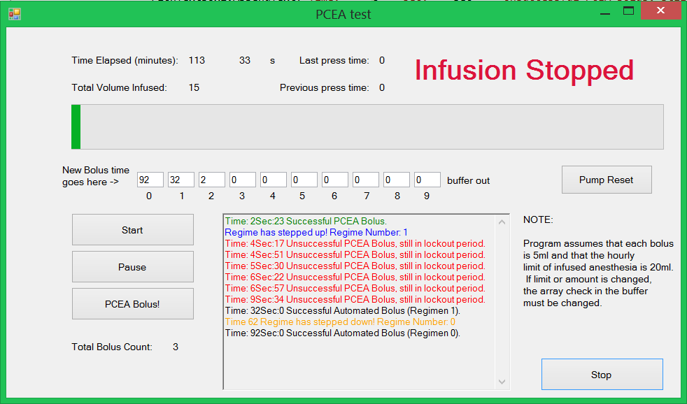
Algorithm Testing

Slide 11
Algorithm Testing
Automated Bolus 60 after last automated bolus
Auto Bolus 30 min after first PCEA
Stage has stepped up as PCEA is triggered
Currently at stage 1
At Time 62, Stage steps down as it is an hour since last PCEA
Start

